Slide 1
How to Develop a CNN for MNIST Handwritten Digit Classification
Presented by: Dalal Alqahtani

Slide 2
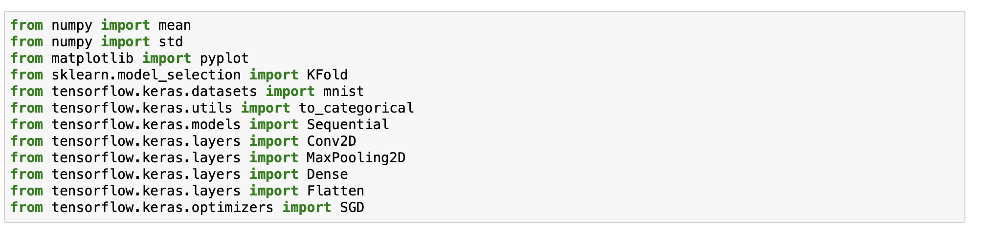
Importing All Libraries:

Slide 3
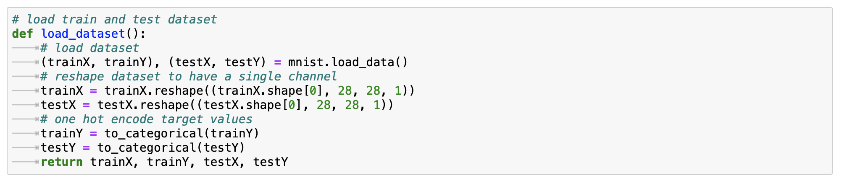
Loading the Training and Testing Dataset:

Slide 4
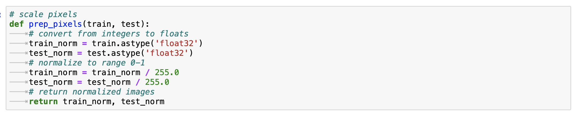
Scaling the Pixels:

Slide 5
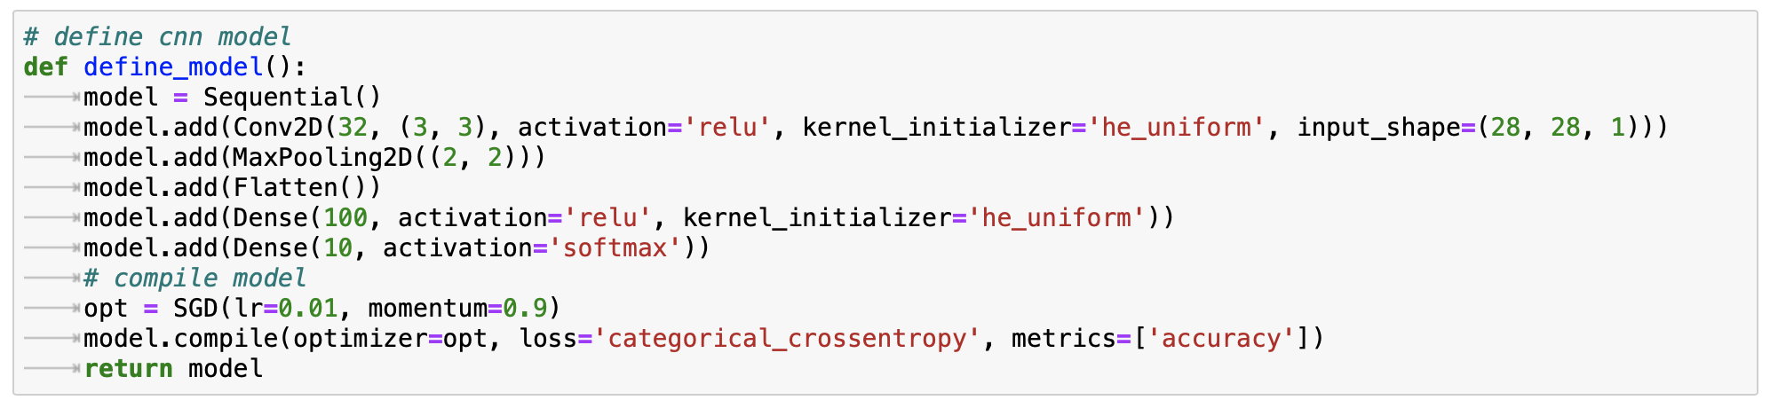
Create the CNN Model:

Slide 6
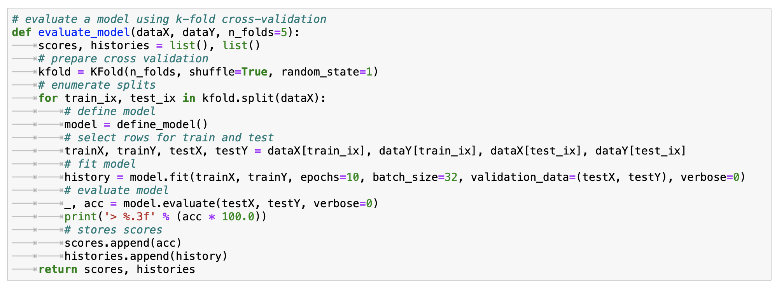
Using the k-flod cross validation:

Slide 7
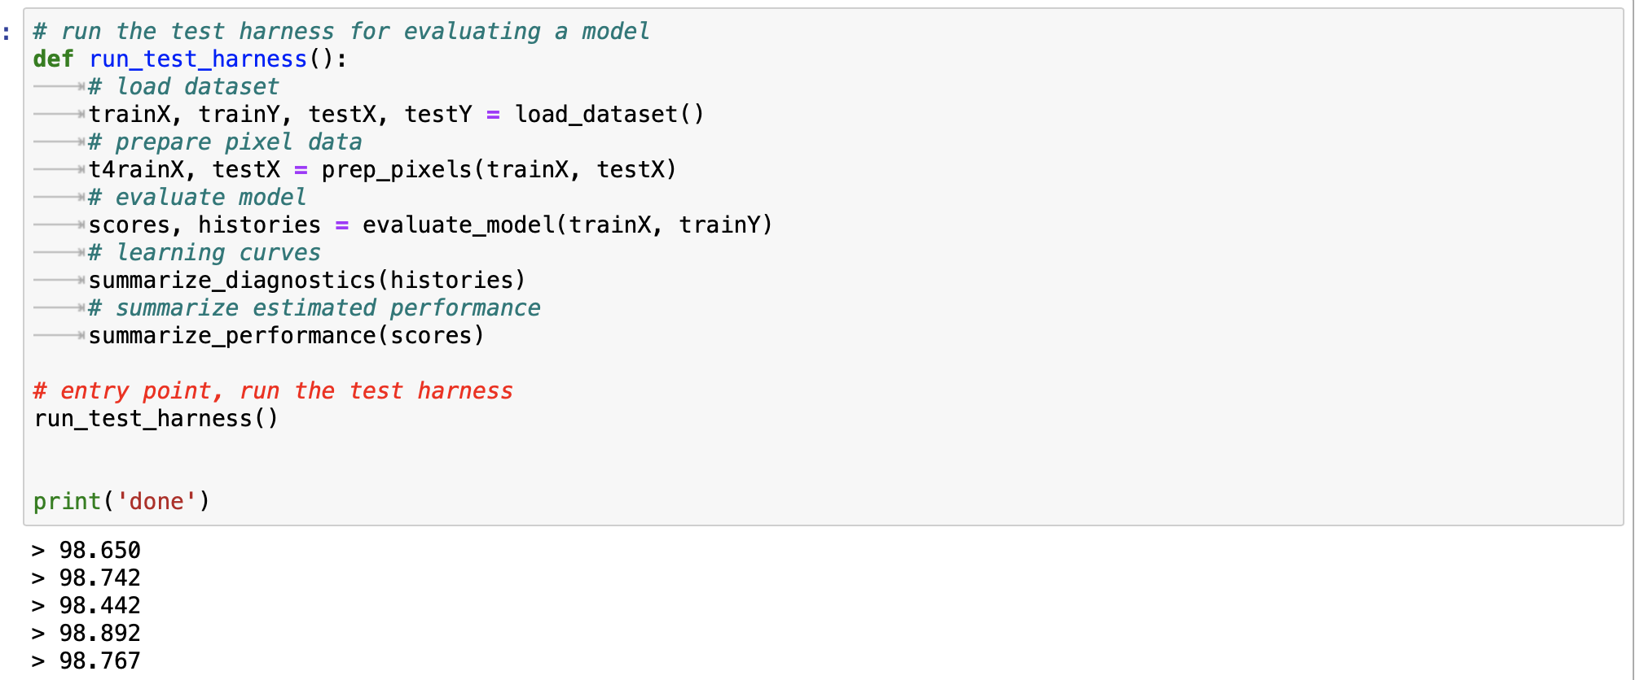
Testing the Model:

Slide 8
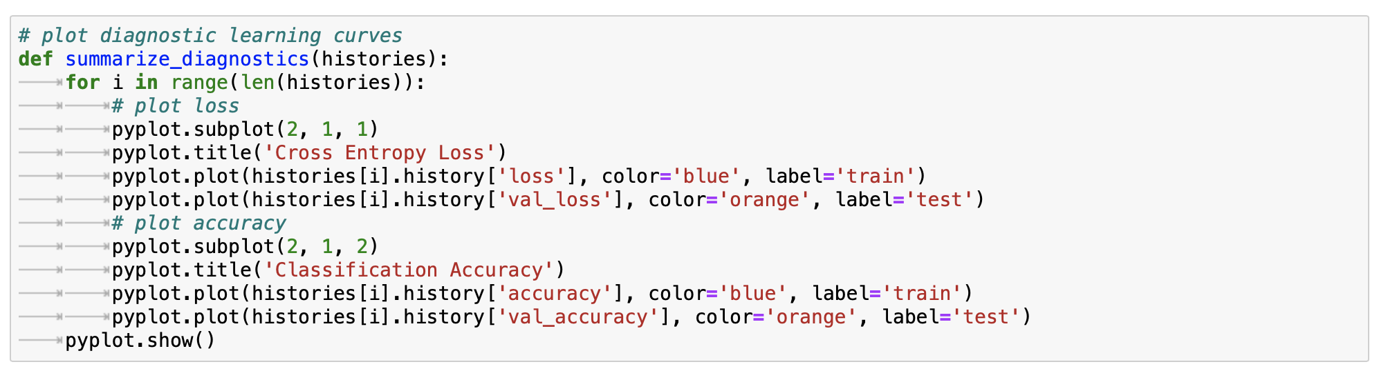
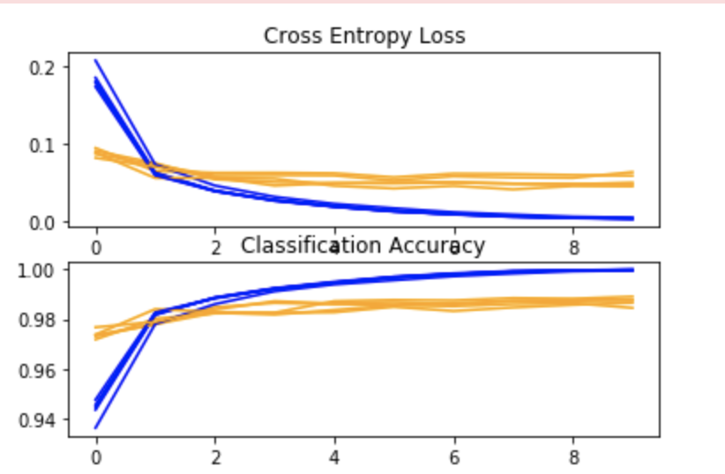
Plotting Two Figures:

Slide 9
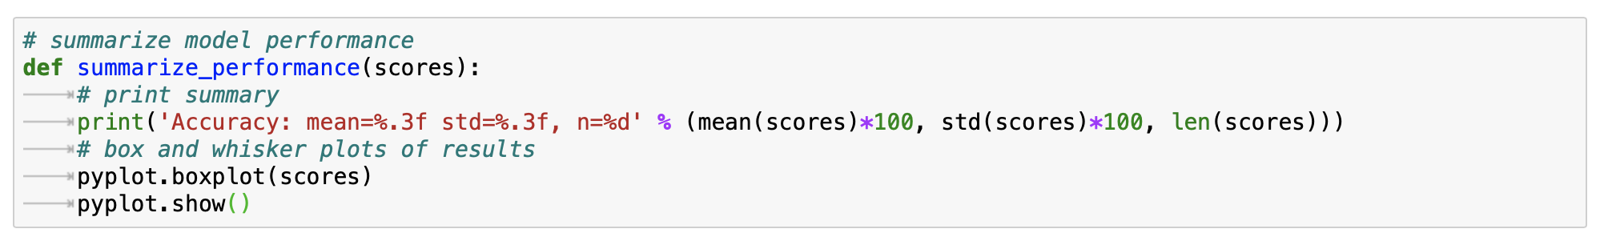
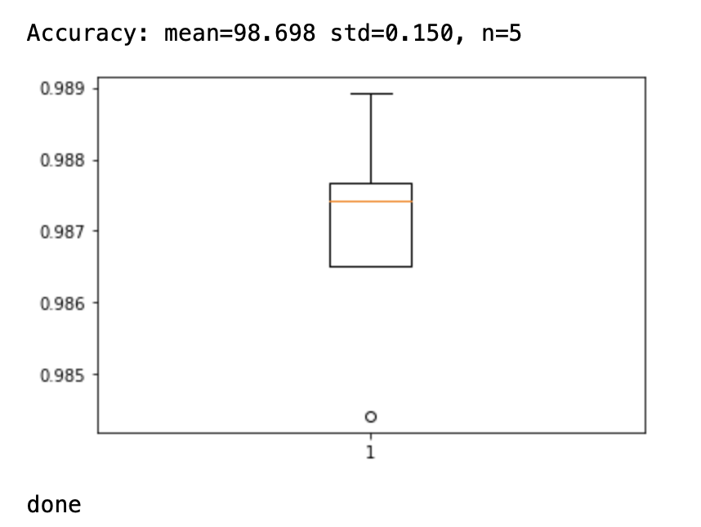
Plotting Two Figures:

Slide 10
References:
https://data-flair.training/blogs/python-deep-learning-project-handwritten-digit-recognition/
https://machinelearningmastery.com/how-to-develop-a-convolutional-neural-network-from-scratch-for-mnist-handwritten-digit-classification/

